Slide 1
Signal Processing and Feature Extraction Part-III
Muhammad Umar
Notes:
ID=d924773e-9a16-4d6d-9803-8cb819e99682 Recipe=text_billboard Type=TextOnly Variant=0 FamilyID=AccentBoxWalbaum_Zero

Slide 2
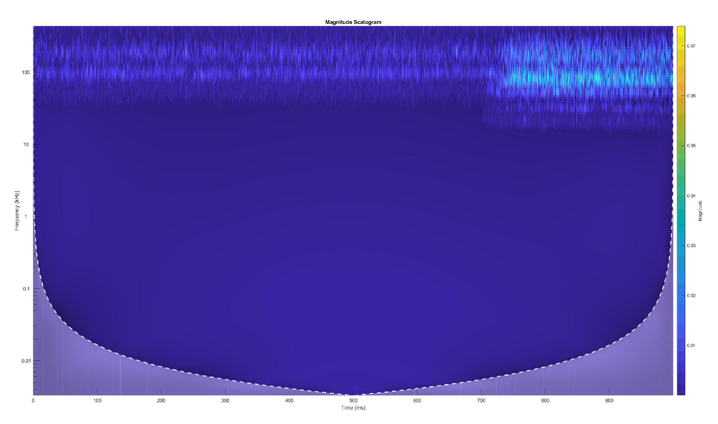
Signal Processing in the Time Frequency Domain
To compensate the limitations of signal processing in both the time and frequency domain.
Figure: Time-Frequency Domain Signal Processing
2

Slide 3
Introduction
Time-Frequency Domain Analysis
Short Time Fourier Transform
Hilbert-Huang Transform
Wavelet Transform
Empirical Mode Decomposition
3

Slide 4
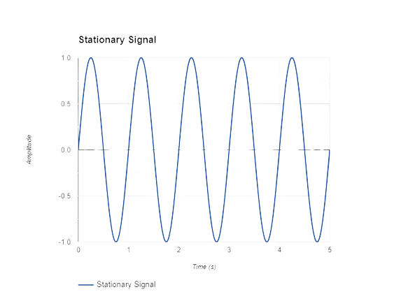
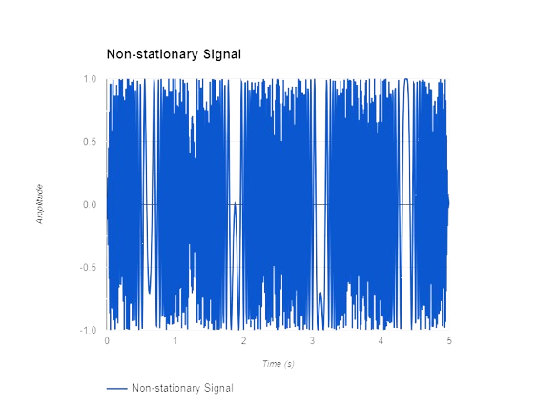
Short Time Fourier Transform
Stationarity of Signal
Stationary
Non-Stationary Signal
Correlation Analysis provide information about the time domain only.
FT only gives what frequency components exists in a signals.
FT not useful for analyzing nonstationary signals.
Solution?
Short-Time Fourier Transform and Wavelet Transform
4

Slide 5
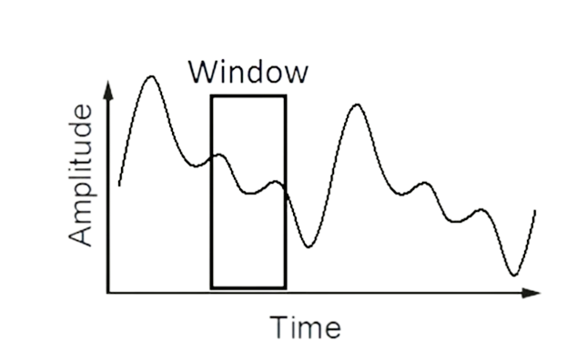
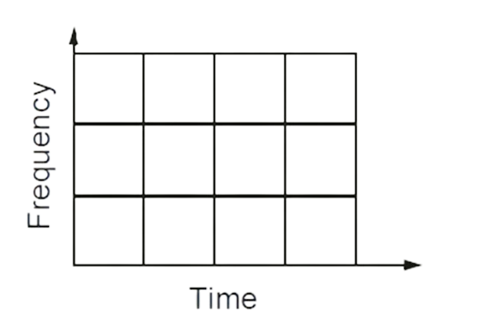
Cont…
Segmenting the signal into narrow time intervals, narrow enough to be considered stationary.
A technique called Windowing the Signal.
Take the Fourier transform of each segment.
Wide Window -> Good frequency resolution but poor time resolution
Narrow window -> Good time resolution but poor frequency resolution
STFT
Problem: Cannot know what frequency exists at what time intervals.
4

Slide 6
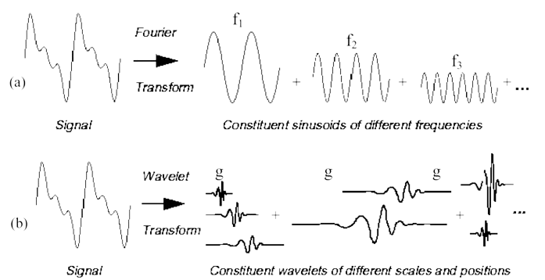
Wavelet Transform
A wavelet is a small wave.
A wavelet Transform is the representation of a function by wavelets.
Figure: Wavelet Transform
5

Slide 7
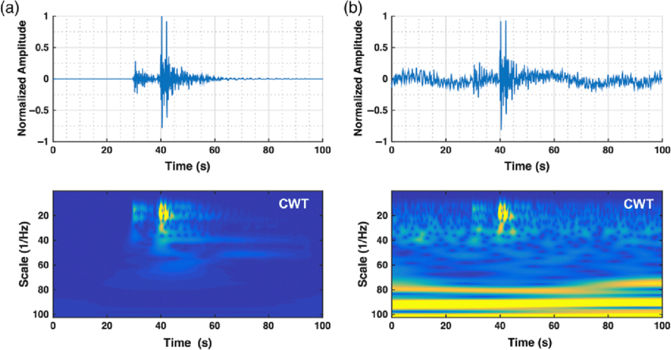
Cont…
Split Up the Signal into a Bunch of Signals
Representing the Same Signal, but all Corresponding to Different Frequency Bands
Only Providing What Frequency Bands Exists at What Time Intervals
Figure: Wavelet Transform
5

Slide 8
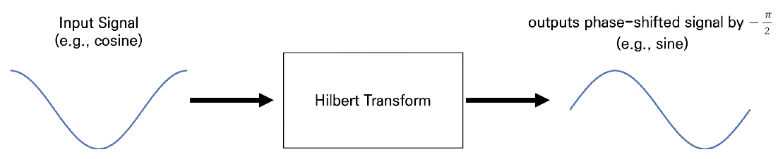

Hilbert-Huang Transform
The Hilbert transform of a signal x(t) is a signal $\hat{x}\left(t\right)$whose frequency components lag the frequency components of x(t) by 90°
$\hat{x}\left(t\right)$has exactly the same frequency components present in x(t) with the same amplitude–except there is a 90° phase delay.
The amplitude of the frequency components of the signal do not change by performing the Hilbert-transform
Figure: Hilbert Transform
6

Slide 9
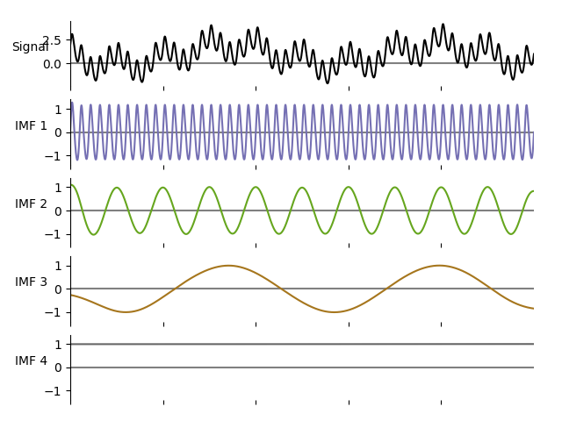
Empirical Mode Decomposition
EMD is a data-driven, adaptive method used to decompose a signal into its intrinsic mode functions (IMFs).
It is primarily used for analyzing non-linear and non-stationary signals.
Figure: Decomposition of signal into IMFs
7

Slide 10
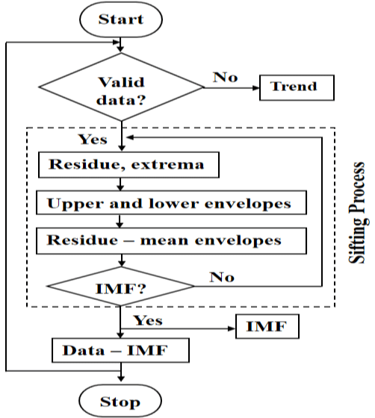
EMD Working
Figure: EMD Algorithm
7

Slide 11
Summary
Addressed the limitations of time and frequency domain methods for non-stationary signals.
In STFT we are segmenting signals into narrow time intervals using windowing techniques.
In Wavelet Transform we are decomposing signals into different frequency bands over time.
Using the Hilbert transform to create phase-delayed signals.
In EMD we are decomposing signals into intrinsic mode functions (IMFs).
10

Slide 12


Thank You
Muhammad Umar
mmumar1758@gmail.com

